Slide 1
UT Dallas Software Quality and Software Testing Part 1 – The Big Picture (How Quality Relates to Testing) Part 2 – Fundamental Concepts of Measurement and Data Analysis Part 3 – Defect Containment Part 4 – Measuring Software Structure Part 5 – Measuring Software Complexity

Slide 2
Dennis J. Frailey Retired Principal Fellow - Raytheon Company
PhD Purdue, 1971, Computer Science
Assistant Professor, SMU, 1970-75
Associate Professor, SMU, 1975-77
(various titles), Texas Instruments, 1974-1997;
Raytheon Co. 1997-2010
Adjunct Associate Professor, UT Austin, 1981-86
Adjunct Professor, SMU, 1987-2019
Adjunct Professor, UT Arlington, 2014-present
-----
Areas of specialty: software development process, software project management, software quality engineering, software metrics, compiler design, operating system design, real-time system design, computer architecture
Notes:
MY BACKGROUND IS OVER 30 YEARS IN COMPUTING
MY FIRST JOB WAS WRITING FORTRAN PROGRAMS FOR THE FORD MOTOR COMPANY’S ENGINEERING & RESEARCH CENTER IN DEARBORN MICHIGAN
I AM ALSO ACTIVE IN PROFESSIONAL SOCIETIES SUCH AS ACM, IEEE, AND THE LOCAL GROUP CALLED ASEE, WHICH IS PART OF THE SPIN NETWORK

Slide 3
Part 3 Defect Containment (Phase Containment)

Slide 4
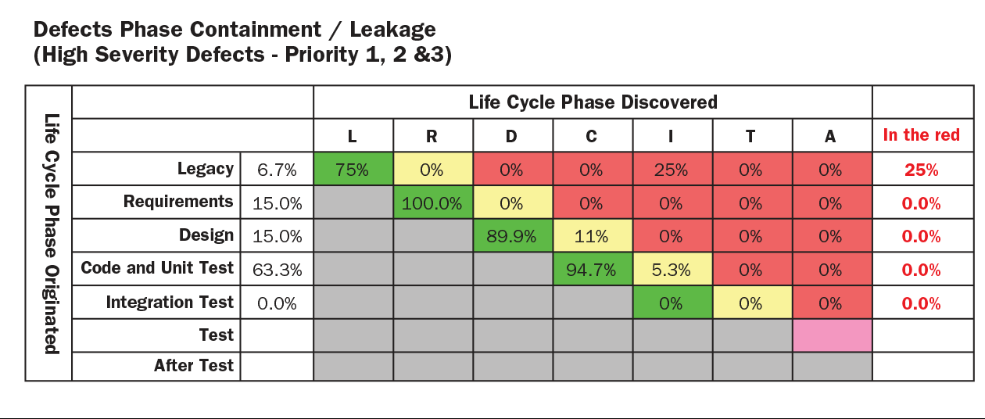
Defect Containment (Phase Containment)
This requires that you collect additional information about each defect you discover during an inspection or as a result of a test:
In what phase of development was the defect created?
In what phase was it detected?
Insights.sei.cmu.edu

Slide 5
Note on Defect Containment
There are several variations on this method
All use the same basic data (base measures) but they use the data in different ways
In this course we will illustrate one of the variations on this method.
You may find others at www.sei.cmu.edu

Slide 6
Example of Defect Containment
Suppose you detect a lot of defects during system test
And suppose you discover that most of them occurred due to bad design procedures
Then you know that the best way to fix the problem is to improve your design procedures

Slide 7
In-Phase Defects
In-phase defects are those that are corrected in the same development phase where they were introduced
- Example: a coding error that is caught and corrected while you are writing the code, before going to system test
Measuring in-phase defects tells you which parts of your process generate large numbers of defects
In-phase defects are generally the least costly to correct.

Slide 8
Out-of-Phase (Leaking) Defects
Out-of-phase defects are those that are detected (and corrected) after they leave the phase where they were introduced
- Example: a design error caught during unit test
Measuring out-of-phase defects indicates how often you allow defects to “leak” from the phase where they originate
this is a predictor of post-release failures
and also a good help in root cause analysis
Finding the Ultimate Cause of a Defect
Out-of-phase defects are generally the most costly to correct.

Slide 9
Defect Containment Analysis Step 1 – Collect the Data
Track Each Defect and Record Phase of Origin
Defect Report
Description ______________
________________________
Phase where found ____
Phase where introduced ___
________________________
Priority _____ Type _____
Estimated Cost to Fix _____
etc.

Slide 10
Defect Containment Analysis Step 2 – Record and Display the Data
Defect Containment Matrix – Sequential Process
Phase where Defect was Inserted
POST REL.
RA
PD
DD
C&T
I&T
This shows the data at the end of the C&T phase
RA
15
Phase where Defect was Detected
PD
12
55
DD
42
8
23
C&T
15
3
8
17
I&T
POST REL.
Notes:
This shows the chart at the end of the C&T phase
The preliminary design phase generated a lot of defects, but caught most of them prior to release
The requirements analysis phase generated a lot of defects that are not caught until later phases
Therefore: improve defect inspections during requirements analysis
Improve method of doing RA and DD

Slide 11
Defect Containment Analysis Step 2 – Record and Display the Data
Defect Containment Matrix – SCRUM Process
Scrum where Defect was Inserted
POST REL.
S1
S2
S3
S4
S5
This shows the data at the end of the 4th SCRUM
S1
15
Scrum where Defect was Detected
S2
12
55
S3
42
8
23
S4
15
3
8
17
S5
POST REL.
Notes:
This shows the chart at the end of the C&T phase
The preliminary design phase generated a lot of defects, but caught most of them prior to release
The requirements analysis phase generated a lot of defects that are not caught until later phases
Therefore: improve defect inspections during requirements analysis
Improve method of doing RA and DD

Slide 12
Defect Containment Analysis Step 3 - Using the Data
If you see many out-of-phase defects in a specific cell, you can narrow down the source of defects
Phase where Defect was Inserted
RA
PD
DD
C&T
I&T
POST REL.
A lot of defects are created during preliminary design
RA
15
Phase where Defect was Detected
12
55
PD
DD
42
8
23
C&T
15
3
8
17
I&T
A lot of defects originate during requirements analysis but are not detected until detailed design
POST REL.

Slide 13
Defect Containment Analysis Step 4 - Using the Data to Provide Additional Insight
Over time, you can correlate
the number of defects in the matrix
to the number of failures found by the customer
You can use this to predict and ultimately to manage the number of failures
A method for doing this will be shown briefly in today’s lecture

Slide 14
Issues with This Method
Definition of a defect must be adhered to in a consistent way across the project
As shown, there is no distinction by type or severity of defect
(but this distinction can also be made if the original data are good enough)
Notes:
Consistency within a project is very important
Consistency between similar types of software is important, but less than within a project
Consistency between dissimilar types of software is useful but not as important

Slide 15
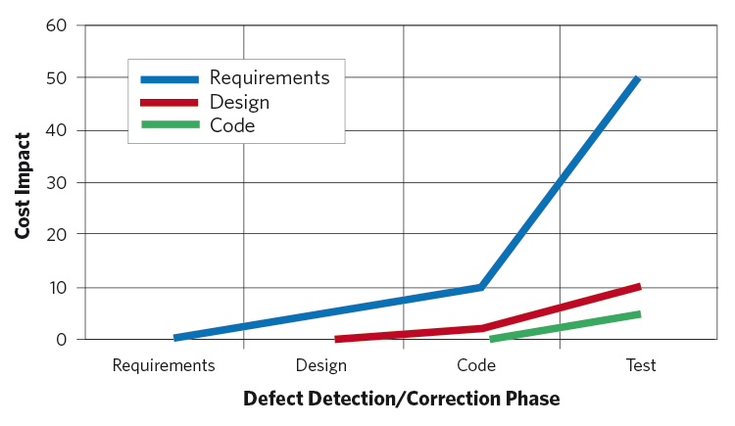
A Key Lesson Learned from Measuring Defect Containment
If you detect and correct defects early, it greatly reduces cost and reduces post-release failures (i.e., those seen by the customer)
But this requires very good understanding of requirements and of customer “care-abouts”
Dau.dodlive.mil

Slide 16
Contained and Leaking Defects
Phase of Injection
In-phase or Contained
Phase of Detection
Out-of-phase or Leaking

Slide 17
Large Numbers Indicate Software Development Process Problems
Large numbers in any column indicate that your development process is generating many defects in that process phase
A large number in a “leaking” cell means you are also paying a lot of money for rework
This tells you where to focus process improvement efforts

Slide 18
A Typical Defect Containment Chart
Least Costly Defects are on the Diagonal
These defects are “Contained” within the step where they were caused

Slide 19
Escaping Defects are Those Not Detected until After Release
Escaping Defects Cost the Most of All

Slide 20

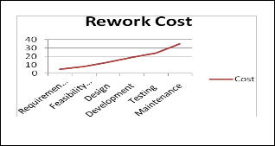
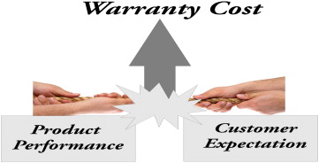
Other Uses of Defect Containment Data
There are many uses of defect containment
Calculating total repair cost
By recording labor cost to repair defects
Calculating rework cost
Reduction in rework can be compared with
cost of prevention activities
Organizational-level analysis
Prediction of defects and warranty costs
Prediction of reliability
Aspennw.com
Ijser.org
Sciencedirect.com

Slide 21
Defect Repair Cost
Labor Cost to Repair Defects
Aspennw.com
Phase of Injection
Cell i,j indicates the
average labor cost
to repair a defect
created in phase i and
detected in phase j
Phase of Detection

Slide 22
Total Repair Cost
If you multiply the defect containment chart by the “labor cost to repair” chart, you get total repair cost
Aspennw.com
Cell-wise
multiplication
Defect Counts
Cost to Repair
Total Repair Cost

Slide 23
Total Repair Cost Example
Aspennw.com
Phase of Injection
Cell i,j indicates the
total labor cost
to repair all defects
created in phase i and
detected in phase j
Phase of Detection

Slide 24
Rework Costs Are The Portion Of the Prior Chart That Are Not On The Diagonal
Ijser.org
Phase of Injection
Phase of Detection
Costs off-diagonal are rework costs

Slide 25

This Concept Applies Throughout the Product Lifetime
Ijser.org
You can track repair cost and rework cost
during development
and
after delivery to the customer
You can further break defects down by characteristics:
Phase of Development where Defect Occurred
Severity
Importance to Customer
Cost to Repair
Time to Repair
Which Part of the Software was Responsible
Etc.
Aspennw.com
Imgkid.com

Slide 26
This Can Help You Justify Process Improvements
Ijser.org
Rework costs are the equivalent of “software scrap”
If you can reduce scrap by investing in defect prevention activities, you can save a lot of money (see earlier modules)
If you make an improvement in your development process, you can use the defect containment chart to show the savings in reduced repair cost
And you can use the chart to determine which parts of the process are most important to improve

Slide 27
Analyzing Defect Data at the Organizational Level
By collecting data from many projects, we can show historical costs for rework
And we can also show patterns of defect containment
Organization Data
Project A Data
Project B Data
Project C Data
Project N Data
…

Slide 28
Organizational Analysis of Defect Containment Data
Analysis of defect containment data for many projects over a period of time
may show such organizational information as:
Most frequent types of defects
Most costly defects
Time required to fix defects
Process steps generating the most defects
Which design standards help or hurt defects
Typically we collect the data needed for
statistical process control:
averages, ranges, distributions, maximum, minimum, etc.

Slide 29
Example: Determining an Organizational Process Metric
Defect Data from SA/SD Projects
Defect Data from OO Projects
SA/SD Defect Pattern
OO Defect Pattern
Notes:
By separating the original defect containment data for Structured Analysis and Design projects from that for Object Oriented projects we can develop patterns that show how they compare in defects.
You can simply add charts for projects with the same process steps and similar definitions of a defect.
You could do similar analysis for cycle time, cost, etc.

Slide 30
Overview of the Cost Data Collection Process for an Organization
Historical Project Data Hours/Defect
Combine project Data
for each table entry.
Analyze each table
entry for mean, std dev..
^{Product 4}
^{Log}
^{Hours}
^{Expended}
RA
PD
DD
CUT
I & T
^{Product 3}
^{Table entry (I,J)}
RA
2
^{Validation}
^{Product 2}
Show a distribution for each cell.
PD
4
2
2
^{Product 1}
DD
6
4
4
2
CUT
8
6
4
I & T
10
8
2
6
^{Count}
Expected range of values for each
table entry.
Compare with Program Experience
Defect History in
Hours/Defect
RA
PD
DD
CUT
I & T
_{C11}
+2
RA
2
_{C21}
_{C22}
PD
4
2
2
_{C31}
_{C32}
_{C33}
DD
6
4
4
2
_{C41}
_{C43}
_{C44}
CUT
8
_{C42}
-2
6
4
I & T
85
8
2
_{C51}
_{C52}
_{C53}
_{C54}
_{C55}
6
^{COST CAPABILITY MATRIX}
^{TABLE ENTRY (I,J)}
^{CAPABILITY}
Out of Range Here!

Slide 31
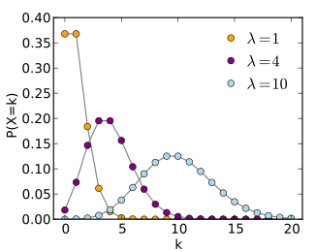
Before We Discuss Additional Uses of Defect Containment …
We need to introduce a special distribution that we haven’t seen before
Poisson Distribution

Slide 32
Contents
Applications of Defect Containment
Poisson Distributions
A Model for Predicting Defect Levels and Associated Costs, Using Defect Containment
Predicting Reliability
Measuring the Cost of Defect Removal

Slide 33
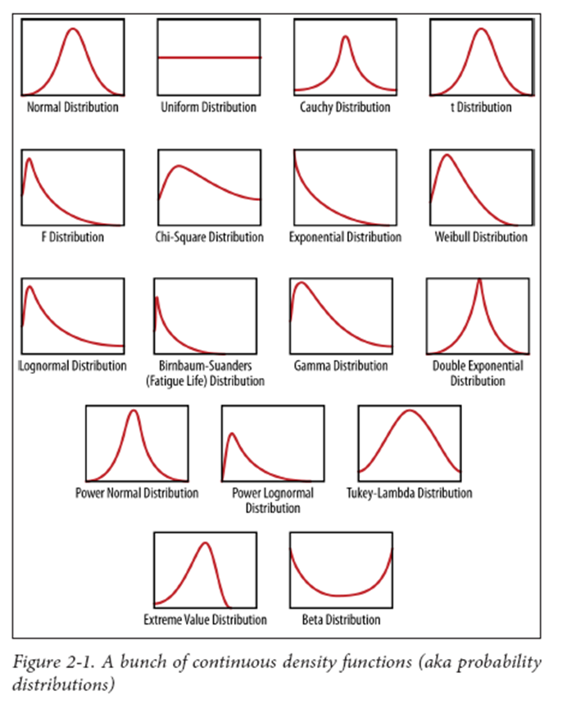
Recall We Introduced Distributions in the Previous Lecture
We mentioned that there are many distributions that correlate to actual data.
Today we will introduce the Poisson distribution

Slide 34
Exponential Distribution Formula
You may be familiar with the exponential distribution function:
Exponential | f(t) = λe^{-λt}

Slide 35
Poisson Distribution Formula
Poisson distribution has a similar formula:
Exponential | f(t) = λe^{-λt}
Poisson | f(t) = λ^{t}e^{-λ} / t!
t! = t factorial (1*2*…*t)
Poisson distribution is only defined for positive integer values of t
For Poisson distributions, λ is the average or mean value of t

Slide 36
Uses of Poisson Distribution
Exponential and many other distributions are used for situations where
the independent variable (t) is continuous
t can be any value or any non-negative value
such distributions are often used for estimating
when an event will occur
such as when a failure or defect will occur
Poisson distribution is used for situations where the independent variable (t) is a discrete, positive integer
Often used for predicting the number of events (for example, number of failures or defects) that will occur in a given time period

Slide 37
Poisson Formula is Often Written Using the Letter k rather than t
To suggest an integer value
f(k) = λ^{k}e^{-λ} / k!
k is a number of occurrences
f(k) is the probability that an event (such as a failure) will occur k times

Slide 38
Poisson Distributions
k (horizontal axis) is number of occurrences
P(X=k) (vertical axis) is the probability that an event will have the indicated number of occurrences

Slide 39
Advantages of Poisson Distribution
Poisson distributions are often used for situations where occurrences are discrete, independent and relatively uncommon
Benefits:
Relatively un-restrictive assumptions
Relatively straightforward derivation and a relatively simple model
Among other things, the mean = the variance, which simplifies many calculations
Thus Poisson distributions are widely used in software reliability modeling

Slide 40
A Practical Note about Calculating Poisson Distributions on a Computer
f(k) = λ^{k}e^{-λ} / k!
If k is large, both λ^{k} and k! may be very large numbers
This may lead to overflow or underflow and, thus, highly inaccurate/unstable calculations
This is a good example of a common situation on computers: what is simple mathematically may not be so simple to implement on a computer

Slide 41
A Mathematically Equivalent But Computationally More Stable Equation
On a computer, you may want to compute the Poisson distribution in this fashion:
Where  is the “gamma function”
In Excel:
GAMMA() is the gamma function: ()
GAMMALN() is the natural logarithm of the gamma function: ln ()
In MATLAB: gammaln()
In C standard library: lgamma()
f(k) = exp{k ln λ - λ - ln (k+1)}

Slide 42
Contents
Applications of Defect Containment
Poisson Distributions
A Model for Predicting Defect Levels and Associated Costs, Using Defect Containment
Predicting Reliability
Measuring the Cost of Defect Removal

Slide 43
We Can Predict Rework and Other Costs from Defect Level
A predictive model, to be introduced in the next several slides, relates future defect levels to defect containment values
For a given project or group of similar projects, we can predict future defects and rework cost
as a function of
the defect level achieved during software development
The model can be applied early in development and continually refined as development proceeds
So you can spot potential trouble early

Slide 44
Predicting Quality A Model Based on Defect Containment
Assumption:
We have a software development process with N phases
L_{i} = the number of defects introduced in phase i
Other Assumptions:
L_{i} has a Poisson distribution with mean λ_{i}
L_{i} and L_{j} are independent for i j.

Slide 45
Continuation of the Model
K_{ij} = the number of defects detected in phase j that originated in phase i
For additional information on this model, see Hedstrom and Watson in the Reference List

Slide 46
The Model
Phase of Injection
Phase of Detection

Slide 47
More of the Model
P_{ij} = the probability that a defect introduced in phase i will be detected in phase j
Assumptions:
The detection forms a Bernoulli process
[in other words, a software development process where the individual steps are independent from each other]
and
Detection of one defect is independent of others

Slide 48
Distribution of Detected Defects
It can be shown that K_{ii} has a Poisson distribution with mean λ_{i}P_{ii}. [Ross, 1993]
It can also be shown that the number of defects leaking from the phase where they were introduced, L_{i} - K_{ii},
has a Poisson distribution with mean λ_{i}(1-P_{ii}).
Reminder: A Poisson distribution is a common assumption when dealing with discrete, independent and relatively rare events. For more on this see Ross or Knuth in references.

Slide 49
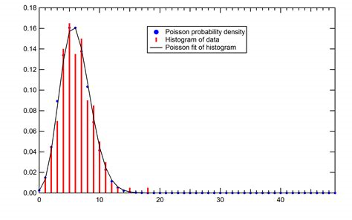
Distribution of Detected Defects (continued)
In general, the number of phase i defects detected in the jth phase (i.e., K_{ij})
has a Poisson distribution with mean:
(1-P_{ii}) * (1-P_{ii+1})*...*(1-P_{ij-1})*P_{ij}λ_{i}
It might look something like this
Quazoo.com

Slide 50
Distribution of Escaping Defects
Let L_{i}* = L_{i} - ΣK_{ij} [j=1..N] be
the number of step i defects not detected by the Nth step of the process
(i.e., the number of escaping defects from step i)

Slide 51
Distribution of Escaping Defects (continued)
It can be shown by induction that L_{i}* has a Poisson distribution with mean:
λ_{i}* = λ_{i} Π (1-P_{ij}) [j=1..N]
which we can rewrite as:
λ_{i}* = a_{i}λ_{i}
where a_{i} = Π (1-P_{ij}) [j=1..N]

Slide 52
Total Escaping Defects
L* = Σ L_{i}* [i=1..N]
is the total number of escaping defects.
It has a Poisson distribution with mean:
λ* = Σ λ_{i}* = Σ λ_{i}Π (1-P_{ij}) = Σ a_{i}λ_{i} [i=1..N]

Slide 53
Leaking and Escaping Defects
Leaking
Escaping

Slide 54
Total Detected Defects
It can also be shown that K_{i} = Σ K_{ij} [j=1..N],
[the total number of defects from stage i which were detected]
has a Poisson distribution with mean and variance given by:
Mean (K_{i}) = a_{i}λ_{i} Σ(P_{ij}/b_{ij}) [j=1..N]
Var (K_{i}) = a_{i}λ_{i} Σ(P_{ij}/b_{ij}) [j=1..N]
where b_{ij} = Π (1-P_{ik}) [k=j..N]
(mean = variance because Poisson)

Slide 55
Estimating Escaping Defects
The K_{i} form a sufficient statistic for estimating the λ_{i} and hence the λ_{i}* and λ*.
Maximum likelihood estimators for the λ_{i} are given in [Hedstrom and Watson, 1995], along with additional details of the model and its derivation.
The point is that
we can estimate escaping defects
as a function of measurable data,
namely the K_{i} and the P_{ij}.
The numbers in the defect containment matrix

Slide 56
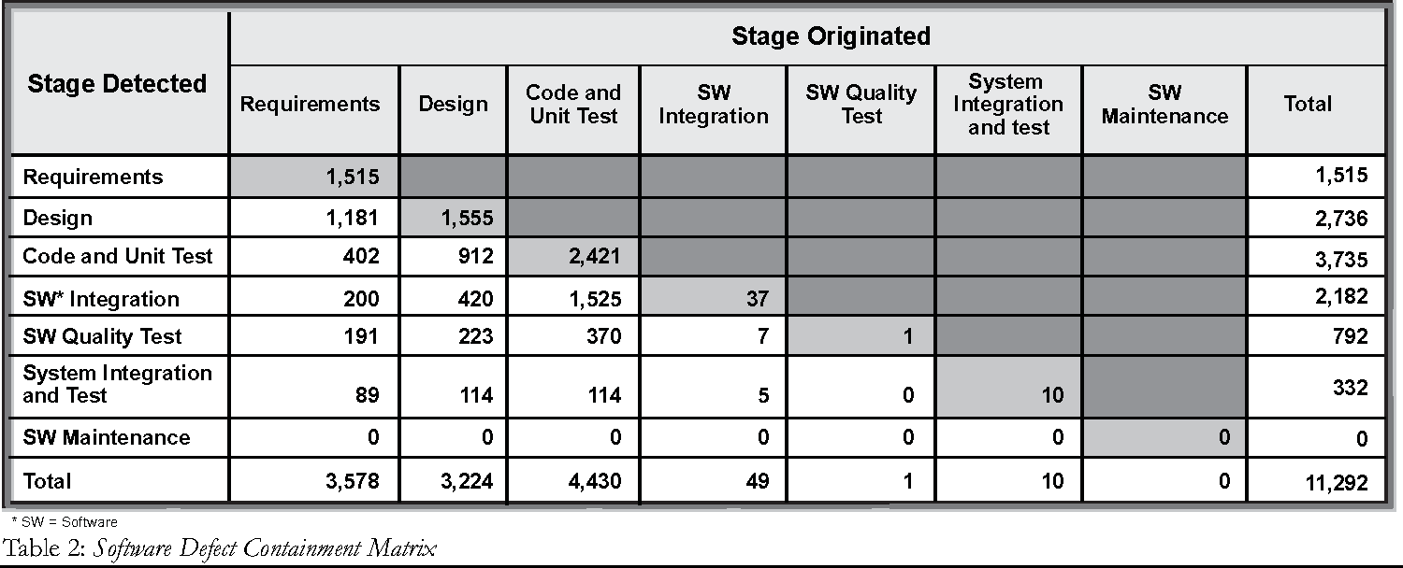

Uses of the Model Defect Predictive Engine
The defect predictive engine is a spreadsheet that
uses the formulas on the previous slides
to relate the final escaping defect level
to the numbers in the defect containment chart
The engine predicts final defect level, given estimated or actual defect levels
Semanticscholar.org
Dreamstime.com

Slide 57
You Can Manage the Process to Achieve a Desired Defect Level
Start with historical data
Populate the defect containment chart with historical averages from your organization
Predict the escaping defects, using the formulas in the model
Augment with actual data
As the development project proceeds, replace the averages with actual project data
Recompute the predicted escaping defect levels
If the levels are too high, refine the process, such as:
More rigorous inspections, testing and peer reviews
More careful development practices
Etc.
Repeat

Slide 58
Example: Quantifying the Warranty Cost for a Software Product (1 of 3)
Consider a software product
with a predicted number of defects.

Slide 59
Example: Quantifying the Warranty Cost for a Software Product (2 of 3)
Consider a software product
with a predicted number of defects.
Estimate the potential cost of warranty work
(labor hours * $xx/hr.).

Slide 60
Example: Quantifying the Warranty Cost for a Software Product (3 of 3)
Consider a software product
with a predicted number of defects.
Estimate the potential cost of warranty work
(labor hours * $xx/hr.).
Total the warranty estimates

Slide 61
Other Ways to Use the Information from the Model and the Engine
Improve defect detection
Model/Engine shows where detection is needed and how it will pay off in two ways:
Reduced rework during development
Reduced warranty cost
Reduce defects by fixing the software development process
Model/Engine pinpoints where the problems are coming from and the potential level of pay off

Slide 62
Contents
Applications of Defect Containment
Poisson Distributions
A Model for Predicting Defect Levels and Associated Costs, Using Defect Containment
Predicting Reliability
Measuring the Cost of Defect Removal

Slide 63




Defects and Reliability are Related, Although Not Always Strongly
As we mentioned earlier in the course, the number of defects may or may not correlate well with reliability
Many studies do show that reliability is related to defect levels in practice

Slide 64
Capers Jones’ Data
See references.
Assembly language code written in the 1970’s.

Slide 65
Escaping Defects and Reliability
Musa [see references] has shown a simple reliability
model that requires an estimate of escaping defects.
λ₀ = fKω₀
λ₀ is the failure rate
f is the rate at which the software is used
K is a small constant indicating which portion of faults are visible as failures
ω₀ is the escaping defect level.
So we could use the defect containment model to predict reliability.

Slide 66
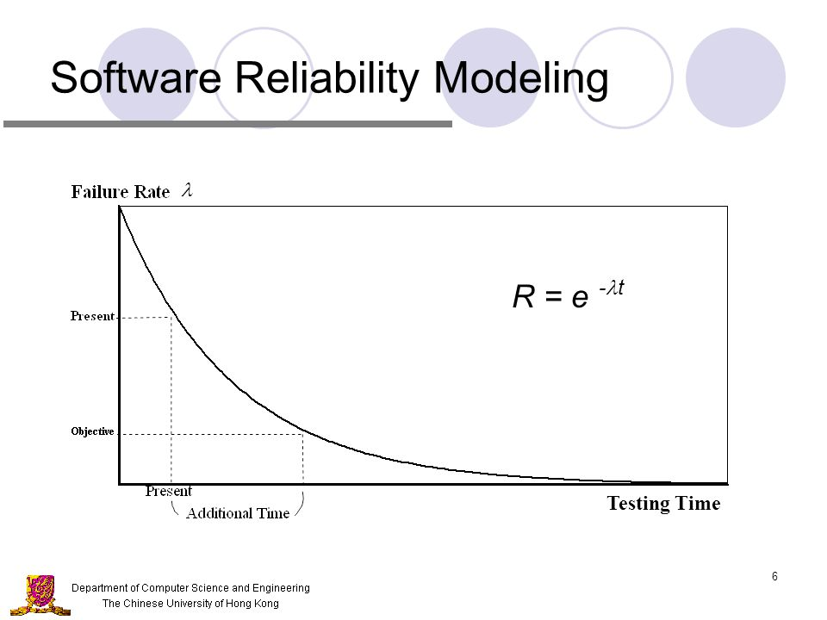
In Your Own Organization ...
Capture data to correlate defects with reliability or repair costs
Find a model, such as Musa’s, that fits your data
Use to predict reliability or repair costs
Slideplayer.com

Slide 67
Part 4 Measuring the Structure of a Program

Slide 68
Contents
Introduction
Some Popular Structure Metrics
Cohesion and Coupling
Coupling
Cohesion
Measures of Data Flow

Slide 69

Contents
Introduction
Some Popular Structure Metrics
Cohesion and Coupling
Coupling
Cohesion
Measures of Data Flow

Slide 70


Possible Goals for Measuring Software Structure (1 of 5)
To identify and admire the beauty of its architecture?
That’s really beautiful code!

Slide 71
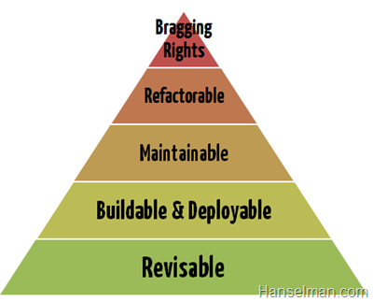
Possible Goals for Measuring Software Structure (2 of 5)
To help us identify structural approaches that are more successful than others
Less error prone
Easier to test
Easier to understand
Easier to maintain

Slide 72

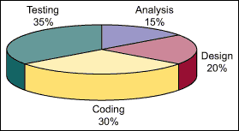
Possible Goals for Measuring Software Structure (3 of 5)
To help us estimate the effort to produce the software

Slide 73
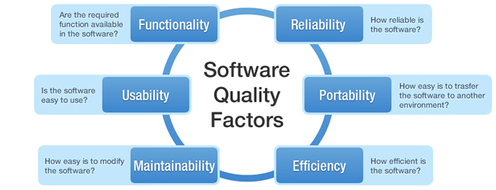
Possible Goals for Measuring Software Structure (4 of 5)
To help us estimate the quality of the software

Slide 74

Possible Goals for Measuring Software Structure (5 of 5)
To help us devise a more effective test plan for the software

Slide 75
Does Structure Relate to These Things?
Intuitively, we believe that the structure of the software relates to its quality and to the effort required to develop, test and support it:
Ease of programming
Ease of understanding
Ease of testing and maintaining
So our information needs tend to be things like:
What aspects of software structure can help forecast development effort and quality?
How should I test this software?
How can I improve my software structure?
How much has it improved?

Slide 76
How Can We Measure Software Structure?
Many have attempted to devise ways of measuring structural aspects of software to see if they can show more specific relationships
For example
Halstead’s attempt to define programming difficulty and level of the language
McCabe’s complexity measures (to be discussed later)
In this lecture we will explore several of the most frequently cited and used methods of measuring software structure and talk about their effectiveness

Slide 77
There are Many Things We Could Measure
Each Level of Abstraction has different Elements to Measure
Statement, function, method, class, package, sub-system, system
We must understand how to describe each Element Measured
Syntax and semantics of the language or notation used to represent the software
Eventually, we must measure attributes of individual components or elements of the design, code, requirements model, etc.

Slide 78
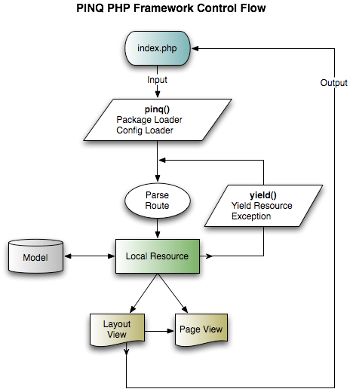
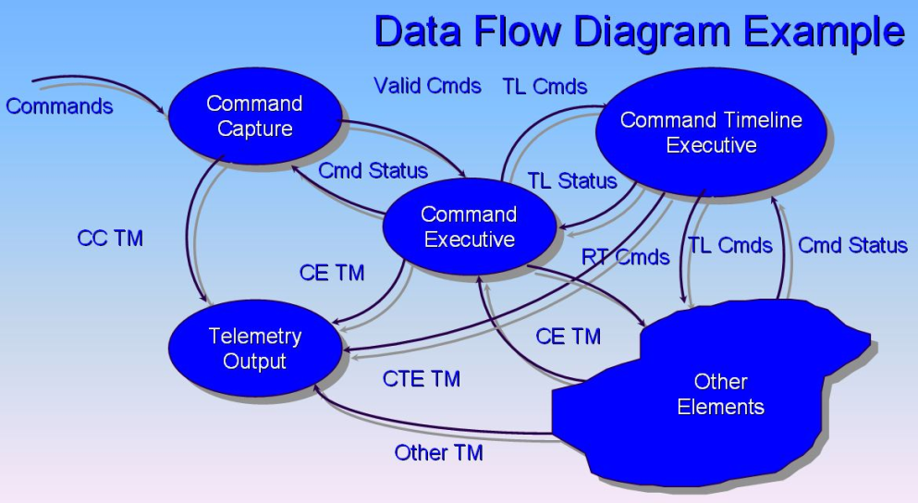
Flow Can Also be Measured
Control Flow
The sequence in which things happen
Loops, parallelism, conditional execution, etc.
Data Flow
The trail of the data as it flows through the program

Slide 79
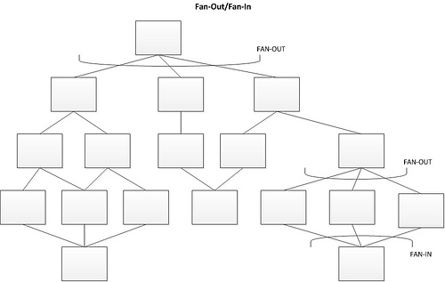
Contents
Introduction
Some Popular Structure Metrics
Cohesion and Coupling
Coupling
Cohesion
Measures of Data Flow

Slide 80
Structural Fan-in and Fan-out
Fan-in – the number of parent modules (the number of modules that call or utilize this module)
Goal: high fan-in at the lower levels of the hierarchy, such as procedures
Fan-out – the number of subordinate modules (the number of modules that this module calls)
Goal: fan-out should be from 5 to 9 (7  2).
This is based on studies of human psychology

Slide 81

Contents
Introduction
Some Popular Structure Metrics
Cohesion and Coupling
Coupling
Cohesion
Measures of Data Flow

Slide 82
Coupling of Modules or Methods -- Overview
Coupling refers to the degree of independence of a program module or method.
If measured for a single module, it indicates the extent to which the module can function (or be understood) without the use of other modules
If measured for a pair of modules, it indicates the extent to which the two modules depend on each other
Goal:
Low or loose coupling is associated with readability, testability and low maintenance cost
Tight coupling is associated with high maintenance cost
The original concept was developed by Stevens, et. al. (see references)

Slide 83
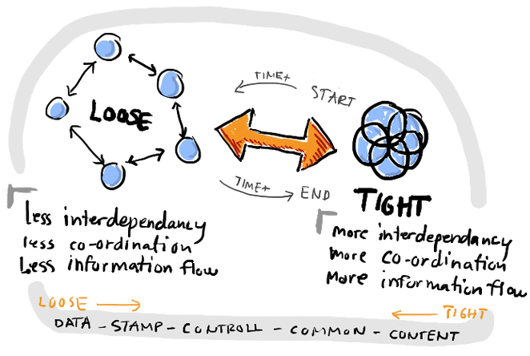
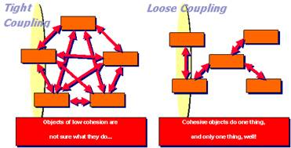
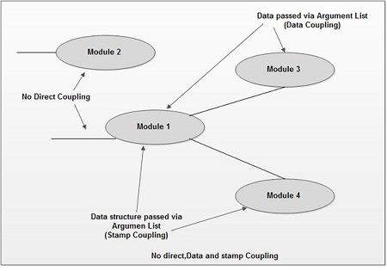
Coupling Diagrams
Dailyfintech.com
Coupling describes how much the modules or methods depend on other modules/methods.
Ecomputernotes.com

Slide 84
Disadvantages of Tight Coupling
Assembly / compiling of modules or methods may be more complicated and take more time, because you have to assemble / compile all of the affected ones
Testing of a module or method is harder
It involves interaction with other modules
Changes to one module or method affect other modules or methods
Consequences of a change are easily overlooked
It is harder to test the consequences of a change
Reuse of a module is more error prone
Software performance may be affected due to the overhead of message/parameter passing and interpretation

Slide 85
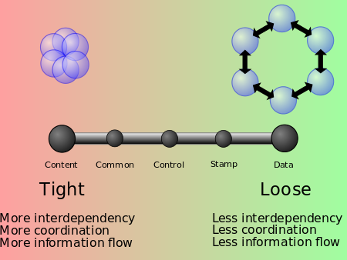
Degrees of Coupling (Myers’ Classification)
En.Wikipedia.org

Slide 86
Degrees of Coupling Defined (slide 1 of 2)
From tightest to loosest (Myers’ classification)
Content coupling: one module modifies or relies on the internal data or other workings of another module.
Common coupling: two modules share the same global data. If the global data is changed in format or content, it affects all modules that use it.
External coupling: two modules share an externally imposed data format, communication protocol or device interface.
For example, both use the same communication interface
Control coupling: one module controls the flow of another, by passing it information on what to do (such as a flag).

Slide 87
Degrees of Coupling Defined (slide 2 of 2)
From tightest to loosest (continued):
Stamp coupling (data structure coupling): modules share a composite data structure and use different parts.
Data coupling: modules share data through parameters or other means.
For example, a subroutine call
Message coupling: modules communicate by message passing.
This is the loosest form of coupling
No coupling: modules do not communicate with each other.
These degrees were proposed by Myers in Stevens, et. al. (see references)

Slide 88
Coupling Measures for OO Designs
There are three categories of coupling for a class
Afferent coupling: The number of responsibilities
Efferent coupling: The number of dependencies
Total coupling: Afferent coupling + Efferent coupling
And there’s a measure computed from coupling info
Instability: The ratio of efferent coupling to total coupling
Other forms of coupling have been defined
Different design methodologies may have different forms of coupling
See Fenton, section 9.4.1 for further examples and details

Slide 89
How to Measure Coupling (slide 1 of 2)
There are many proposed methods of measuring coupling, varying somewhat with the kind of programming and other factors
For procedural languages, Stevens et. al. proposed the following formula for measuring the coupling of a single module or method:
For data and control flow coupling:
d_{i} = number of input data parameters
c_{i} = number of input control parameters
d_{o} = number of output data parameters
c_{o} = number of output control parameters
(continued on next slide)

Slide 90
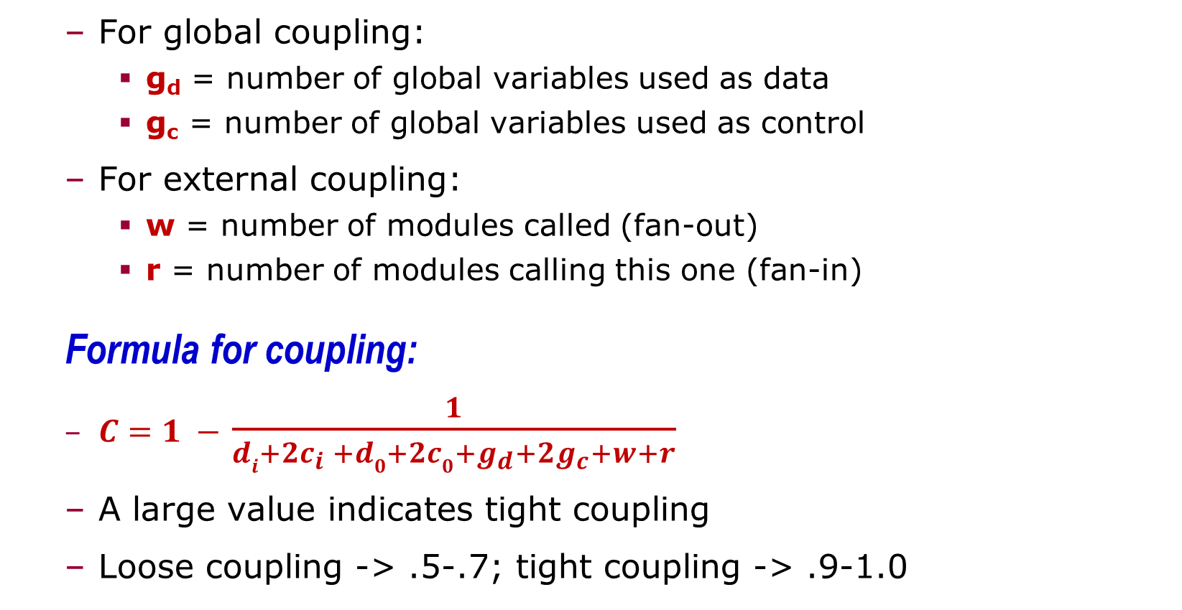
How to Measure Coupling (slide 2 of 2)
For global coupling:
g_{d} = number of global variables used as data
g_{c} = number of global variables used as control
For external coupling:
w = number of modules called (fan-out)
r = number of modules calling this one (fan-in)
Formula for coupling:
$C=1 −$ $\frac{1}{di+2c_{i} +d0+2c0+g_{d}+2g_{c}+w+r}$
A large value indicates tight coupling
Loose coupling -> .5-.7; tight coupling -> .9-1.0

Slide 91
Fenton and Melton’s Measure of Coupling¹ for a Pair of Modules or Methods
C (x,y) = i + n / (n+1)
x and y are modules or methods
n = the number of interconnections between x and y
i = the level of the tightest coupling between x and y
i = 5 for content coupling
i = 4 for common coupling
i = 3 for control coupling
i = 2 for stamp coupling
i = 1 for data coupling
i = 0 for no coupling
¹ Fenton and Melton (see references)

Slide 92
Observations on Coupling
There are many studies that suggest tight coupling is associated with higher cost, higher error rates, and greater difficulty in developing, testing and maintaining software
However there are many variations on exactly how to measure coupling
This is an example of the kind of situation where the engineer finds something that works and uses it whereas the researcher spends countless hours trying to define a superior approach.
Advice: always use common sense. Don’t put blind trust in any measurement that is as imprecise as this one.

Slide 93
Use of Coupling in Real Software Development
As a principle of good design, programmers should always seek to have loose coupling.
When coupling is needed, programmers should always document what modules are affected by any messages, variables, parameters, etc.
Measurements of coupling can help you identify areas of the code that should be redesigned or refactored to make them simpler and less coupled, if possible.
Identifying the degree and nature of coupling can help you define more appropriate test approaches.

Slide 94
Contents
Introduction
Some Popular Structure Metrics
Cohesion and Coupling
Coupling
Cohesion
Measures of Data Flow

Slide 95
Cohesion
Cohesion refers to how well the parts of the module or the methods of a class relate to each other.
A module/class is cohesive if all of its functions are closely related to each other.
Cohesion is desirable because it is easier to understand the module or class if there is a single, unifying theme for what it does.
The module or class makes sense as a meaningful unit
Various functions related to that theme would tend to use the same terminology, have the same sorts of exceptions, the same data types, and the same sorts of errors.
Most work on cohesion has been focused on object oriented methods rather than procedural methods.

Slide 96
Evaluating Cohesion
A simple way to judge cohesion is to determine how succinctly the module can be described.
A short and precise sentence generally describes a cohesive module.
“This module handles input/output”
The above module could easily have a descriptive name, such as “InputOutputFunctions”
A longer and less precise sentence suggests a non-cohesive module.
“This module factors the data, performs various services and handles the I/O”
Words such as “various” and “assorted” and “variety” in the description are typical of non-cohesive modules

Slide 97
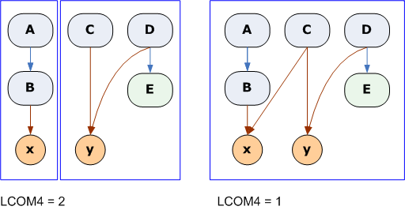
Example
LOW COHESION
This module or class has two separate functions or groups of methods that are unrelated.
HIGHER COHESION
This module or class has functions or methods that are strongly related

Slide 98
Advantages of Cohesion
If you need to replace part of the module or class it is likely that you will replace most or all of it
So you can simply replace the whole thing rather than removing parts of it and leaving other parts alone
You avoid inadvertently damaging one part while modifying another part
Interfaces to cohesive modules tend to be cleaner and more coherent
High cohesion promotes encapsulation
Placing of related data and functions into a single component
Low cohesion generally means inappropriate design with high complexity

Slide 99
Observations About Cohesion
Generally speaking, high cohesion and low coupling tend to go together
But not always
Cohesion of a class may mean that the methods in that class are strongly coupled, which may make it harder to test and maintain
This is a potential drawback, which illustrates why one should not always insist on high cohesion
Cohesion of a procedure has similar drawbacks regarding its internal components.

Slide 100
How to Measure Cohesion
Various metrics have been proposed, under the name “Lack of cohesion metric” or LCOM. Most make more sense for OO software.
LCOM1: This is measured for two methods in a class or two separate sub-functions of a procedure
Let P = The number of disjoint sets of variables accessed by the two methods/sub-functions
Let Q = 1 if the two methods/sub-functions access at least one common variable; otherwise, Q = 0
LCOM1 = P-Q
If P = 0, the methods/sub-functions are cohesive
If P > 0 they are not, and could be separated.

Slide 101
Drawbacks of LCOM1
Makes more sense for pairs of methods than for classes
Only one value (LCOM1 = 0) is defined for cohesive situations, which means it doesn’t measure the “degree of cohesiveness”
The definition doesn’t account for certain classes of global and other shared variables (details vary with the specific OO methodology being used)
For more on LCOM1 see Chidamber and Kemerer in reference list.

Slide 102
LCOM2 and LCOM3 Both measure the degree of cohesion
m = the number of methods in a class or sub-procedures in a procedure
a = the number of variables or attributes in a class or sub-procedure
mA = the number of methods that access a specific variable or attribute A
Sum(mA) = sum of the mA values for all attributes or variables
LCOM2 = 1 – Sum(mA)/(m*a)
This ranges from 0 to 2
0 is good, 1 is not good, 2 is very bad
LCOM3 = (m – Sum(mA)/a) / (m-1)
This ranges from 0 to 1
0 is good, 1 is not good
see Henderson-Sellers in reference list.

Slide 103
LCOM4
This measures the number of connected components in a class.
A connected component is a set of related methods (and class level variables). Ideally there should be only one connected component in a class.
Two methods are related if:
They both access the same class-level variable, or
One of them calls the other one
To measure LCOM4, you determine which methods are related and draw a directed graph, showing the relationships
We will discuss directed graphs later.

Slide 104
Interpreting LCOM4
LCOM4 = 1 means high cohesion
LCOM4 > 1 means lower cohesion
LCOM4 = 0 means a class with no methods

Slide 105
Summing Up Cohesion
There are many measures of cohesion, including some we have not discussed
but none have been universally accepted
Cohesion is a good design goal for most software
Good cohesion often means low coupling, which is also a good design goal
But measures of cohesion vary in their usefulness, depending on the design methodology and other factors
So use them with caution
Lack of cohesion generally means that testing will be more difficult

Slide 106
Contents
Introduction
Some Popular Structure Metrics
Cohesion and Coupling
Coupling
Cohesion
Measures of Data Flow

Slide 107
A Fundamental Issue with Data Flow Measures
IEEE Standard 982.2 defines a series of informational flow complexity measures
But the software development community has adopted a number of variations on these
None of these have been accepted as a standard, because there are so many variations.
Many of these depend on the specific methodology or language being used
We will mention some of the differences

Slide 108
Measures of Data Flow
Informational Fan-in (IFIN): Information flow into a procedure or method
IFIN = PC + PR + GVR
PC = number of procedures calling this one
PR = number of parameters read
GVR = number of global variables read
Informational Fan-in (IFOUT): Information flow out of a procedure
IFOUT = CP + PR + GVR
CP = number of procedures that this one calls
PW = number of parameters written to [by reference]
GVW = number of global variables written to
There are several variations on exactly what is counted as information flow into or out of a procedure or method
For more info, see Henry and Kafura in reference list

Slide 109
Additional Measures of Data Flow - IFIO
Informational Fan-in x Fan-Out (IFIO):
IFIO = IFIN * IFOUT
This is supposedly a good measure of the effort required for implementing the procedure
But it is not necessarily a good measure of its overall complexity
i.e., IFIO is not necessarily a good measure of how hard it is to understand, test or maintain)

Slide 110
Additional Measures of Data Flow - IFC
Informational Flow Complexity (IFC):
IFC = IFIO * IFIO [in other words, IFIO²]
This is the IEEE standard definition
IC1 = LOC * IFIO [in other words, size * IFIO]
This is a widely used definition of information flow complexity
Some authors believe that IFC is a good measure of how hard it is to understand, test or maintain the software

Slide 111
Information Flow Observations
Regardless of how measured, high information flow complexity is generally not a good thing with most modules or methods
Procedures or methods with high information flow complexity are good candidates for redesign because they may be hard to understand
They may require extensive testing
On the other hand, some software may be designed to intentionally have a method or module responsible for a large amount of information flow

Slide 112
Things You Can Discover from Information Flow Metrics
More than one function is required to implement a procedure (lots of information flow between the functions)
Is there a good reason for this from a design perspective, or is this a candidate for redesign?
Stress points in a system (places where there is a lot of information traffic)
This may indicate parts of the software that will have performance issues
Excessive functional complexity
The difficulty of implementing and testing a function due to the complexity of what it must accomplish

Slide 113
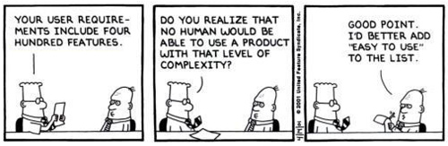
Functional Complexity
This is a current research topic
See Lavazza and/or Abran in the reference list

Slide 114
END OF
Part 4
Notes:
This sign indicates it is time for one of the two breaks in the class

Slide 115
Part 5 Measuring Software Complexity

Slide 116
Contents
Complexity: what and how to measure
Structured Programs and Flowgraph Analysis
Measures of Complexity
Closing Remarks

Slide 117
Contents
Complexity: what and how to measure
Structured Programs and Flowgraph Analysis
Measures of Complexity
Closing Remarks

Slide 118
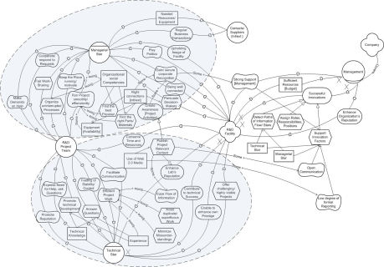
Complexity
We tend to think that complex software is more difficult to develop, test and maintain and has greater quality problems.
But what do we mean by complexity?
Dictionary definitions of complex:
Composed of many interconnected parts
Characterized by a very complicated arrangement of parts
So complicated or intricate as to be hard to understand

Slide 119

Complex vs Complicated
Complicated: being difficult to understand but with time and effort, ultimately knowable
Complex: having many interactions between a large number of component entities.
As the number of entities increases, the number of interactions between them will increase exponentially
It can get to a point where it would be impossible to know and understand all of them.
Hotel-r.net

Slide 120
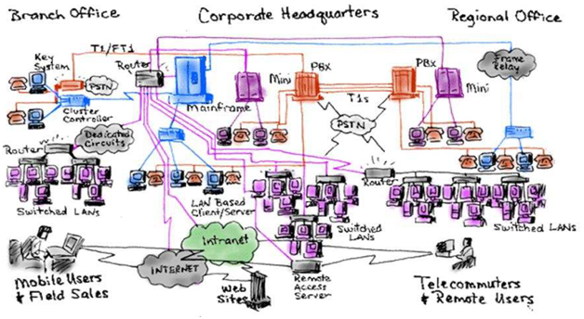
Changing Complex Software
Higher levels of complexity in software increase the risk of unintentionally interfering with interactions and so increase the chance of introducing defects when making changes.
In more extreme cases, complexity can make modifying the software virtually impossible. Changes introduce more problems than they fix. This is called inherent instability.
Labs.Sogeti.com

Slide 121
Can We Measure Complexity?
Measures of complexity would need to address:
the parts of the software,
the interconnections between the parts,
and the interactions between the parts.
Information Need
Something that will help us estimate
difficulty of programming,
difficulty of testing and maintaining,
expected level of quality
Something that will help us evaluate and improve our software with regard to the above characteristics

Slide 122
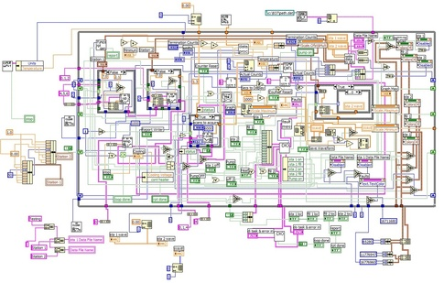
How Can We Measure Complexity?
The base measures would quantify the attributes of:
The parts or components of the software
How many parts or components there are
The arrangement of the parts
The interactions of the parts

Slide 123
Compound Measures
Combining the base measures into calculations that help us address our information needs, answering questions such as:
What aspects of software structure can help forecast development effort and quality?
Is my software structure good?
How should I test my software?
How can I improve my software structure?
How much has it improved?

Slide 124
What Can We Measure?
We might learn something about the structure and complexity of software by measuring:
Requirements
Models, use cases, test cases
Architecture and Design
Models, design patterns, structure, control flow, data flow
The code itself
Statements, variables, nesting, control flow, data flow
The way the code is assembled to produce the final product
Load files, use of libraries

Slide 125
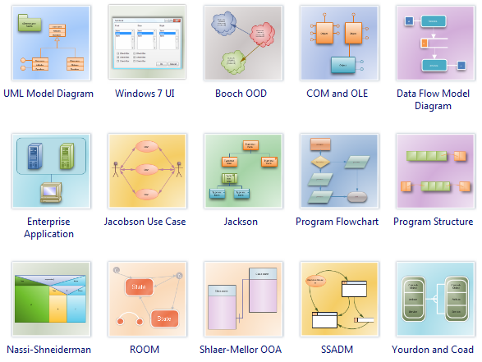
One Problem Is That There are Many Systems for Describing Software Structure

Slide 126
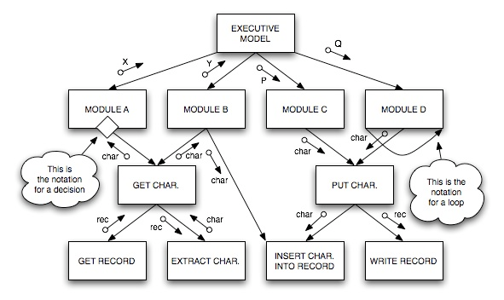
Generally Speaking We Measure Complexity of Systems and of Components that Make up Systems
We usually start with the architecture of the system
This is the architecture of a system defined using structured analysis. There are complexity measures for the system and for the individual components.

Slide 127
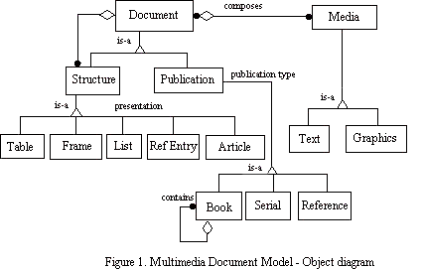
With Object Oriented Systems, the Nature of the Components Varies with the Methodology
This means we must sometimes devise methodology-specific measures
This is the architecture of a system defined using object oriented methodology. There are complexity measures for the system and for the individual components.

Slide 128
Order of Presentation
We will focus on complexity of structured, procedural software
Because this is where most of the research has been focused
Because the results apply to software in many different languages
Because most of the results also apply to object oriented software
From time to time we will mention how the concepts are applied to object oriented software

Slide 129
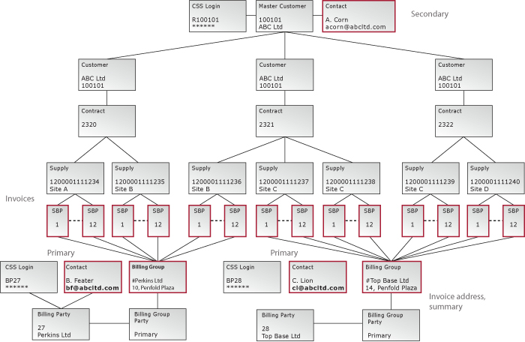
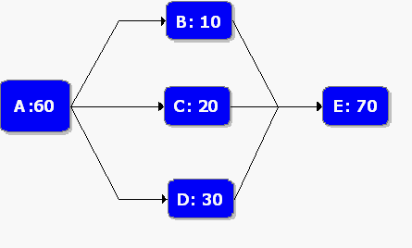
System Level Complexity
Fundamentally, the complexity of a system depends on the number of components and the number of links between the components of the system
It can be further complicated by the degree to which the components share common elements (coupling)
VS

Slide 130
Contents
Complexity: what and how to measure
Structured Programs and Flowgraph Analysis
Measures of Complexity
Closing Remarks

Slide 131
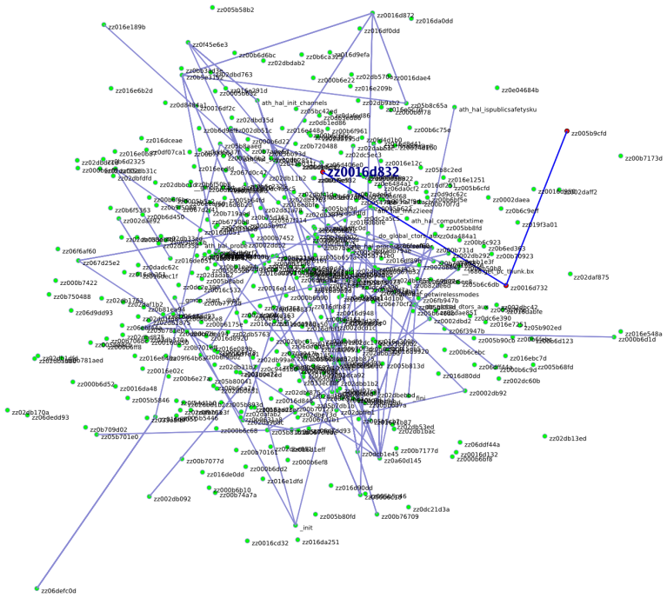
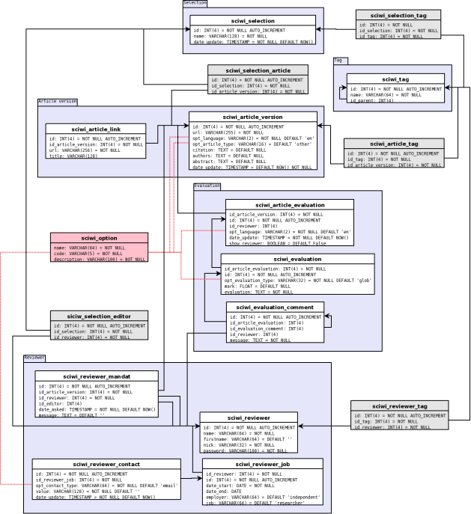
Control Flow Captures Major Complexity-related Attributes
Our intuitive notions of complexity would say that when there are more parts and more complex ways they interact, we have more complex software.
vs
Many measures of complexity make use of control flow analysis.

Slide 132
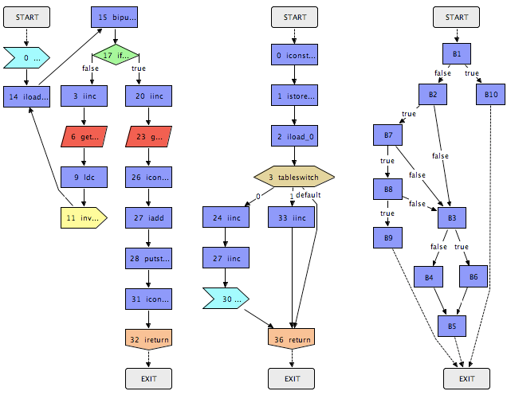
Control Flow is Often Modeled with Directed Graphs
Node
Arc or Edge
This could be flow within a system or within a module

Slide 133
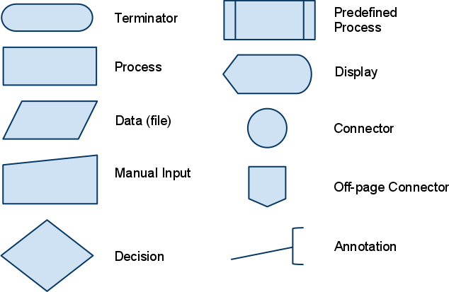
In Many Notations, the Shape of the Node Conveys the Nature of What it Represents
For example, flowcharts:

Slide 134
Notation To Be Used Here (in these slides)
Arc or Edge
Procedure Node
A block of code. Any decisions are internal to the block. One exit.
Predicate Node
One that makes a decision.
Start Node
Stop Node
A path between nodes
E
Squarish shape, Exactly one arc leaving
Round shape, Two or more arcs leaving
F
Colors of procedure and predicate nodes are not part of the notation.
Colors are used only to clarify points being made on a slide.
D
or
G

Slide 135
A FlowGraph
A flowgraph is a directed graph with
One start node, and
One end node,
that has the following property:
Every other node lies on a path between the start node and the end node
Notes:
This notation works for any procedural programming language
But not all languages can represent all possible flowgraphs
Certain common language constructs have readily recognized flowgraph forms
See later slides or Fenton, page 379 for some examples.

Slide 136
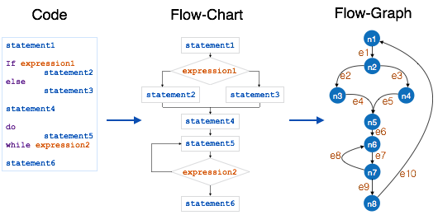
Example: Code, Flowchart, and Flowgraph

Slide 137
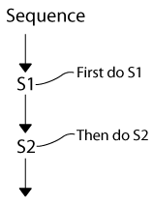
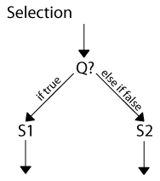
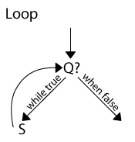
What is a Structured Program?
A structured program is one constructed out of three fundamental control structures:
Sequence (ordered statements and/or subroutines)
Examples: A = B+C; D = FUNC(E,F)
Selection (one or more statements is executed, depending on the state of the system)
Example: If C1 Then <true option> Else <false option>
Iteration [loop] (a statement or block is executed until the program has reached a certain state)
Examples: While; Repeat; For; Do… Until

Slide 138
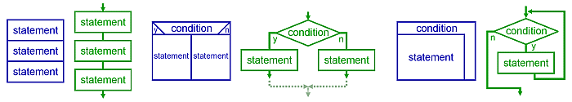
Structured Program Notation
Sequence Selection Iteration (Loop)
Blue: NS Diagram notation; Green: Flowchart notation

Slide 139
These Three are Sufficient to Represent Any Program
The structured program theorem, also known as the Böhm-Jacopini theorem, says that the class of flowgraphs representing the three control structures above can compute any computable function
Note: This does not necessarily mean it is the only way or the best way.
The theorem simply states that it is possible to represent any function with only the three control structures.

Slide 140
Why Are Structured Programs Important?
Studies have shown that limiting the software to a small number of well defined control structures has these benefits:
Easier to understand
Less error prone
Easier to analyze and test
Easier to measure
This started out as a theoretical concept, developed by Edsger Dijkstra and others.
It became more widely known when Dijkstra wrote his famous “Go To Considered Harmful”¹ letter to the editor of Communications of the ACM (in 1968).
¹ See References

Slide 141
There May Be More Than One Flowgraph Representing A Particular Kind of Control Structure
Example: Two flowgraphs for selection
A
A
Each of these is also a “prime” flowgraph, meaning it cannot be reduced to a simpler form. We’ll discuss this further in later slides.
True
True
False
False
X
X
Y
End
End
If A then X
(D₀)
If A then X else Y
(D₁)

Slide 142
Two Prime Flowgraphs for Iteration
A
X
False
True
X
B
False
End
End
True
While A Do X
(D₂)
Repeat X Until B
(D₃)

Slide 143
Prime Flowgraphs and D Notation
A prime flowgraph is one that cannot be reduced (to a simpler flowgraph).
D₀, D₁, D₂ and D₃ are all prime.
See discussion of “reduction” in later slides.
The D notation is a widely recognized way of denoting certain standard, prime flowgraphs.
If A then B
(D₀)
This is a standard type of flowgraph, known as a D₀ structured flowgraph.

Slide 144
The Flowgraphs D₀-D₃ (and sequencing) Can Be Used To Represent Any Program
As a result, some define a program to be “structured” only if it is represented by a combination of these flowgraphs.
However, there are several additional prime flowgraphs that represent commonly used language constructs and that can greatly simplify some programs.
So different organizations and researchers have defined additional prime flowgraphs that may be permitted in “structured” programs.
In other words, every organization defines structured in its own way.

Slide 145
Structured Program Flowgraphs: What Is Common and What Is Not
What all structured programs have in common
Definitions of edges, nodes, etc.
Built out of the three fundamental constructs: sequence, selection, and iteration
It must be possible to reduce a program to a combination of a selected set, S, of prime flowgraphs
What is Different
Which prime flowgraphs are included in the set S.
See Fenton, section 9.2 for a discussion of flowgraphs and structure and, in particular, section 9.2.1.2 for a generalized notion of structuredness.

Slide 146
An Example of Why Additional Prime Flowgraphs are Useful
IF A or B THEN X
ELSE Y
A
If only D0 and D1 can be used to represent this code, then we must use a D1 within another D1 and must show X twice.
This is the equivalent of rewriting the source code as shown below.
False
True
B
True
False
X
X
Y
IF A THEN X
ELSE
IF B THEN X
ELSE Y
X must be duplicated. If X is a lot of code this is inconvenient.
D
End

Slide 147
D₅ Was Introduced To Allow Common Boolean Selection Decisions
A
A
A
A
False
True
True
False
True
True
False
B
B
False
False
True
True
False
X
X
Y
Y
X
X
Y
End
End
End
End
If A then B
(D₀)
If A then B else C
(D₁)
If A or B then X else Y
(D₅)
If A and B then X else Y
(D₅)

Slide 148
D₄ Was Introduced to Allow Middle-Exit Loops
X
A
X
False
True
A
X
B
True
End
End
End
True
False
False
While A
Do X
(D₂)
Repeat X Until B
(D₃)
Y
Do X
Exit when A
Do Y
Repeat
(D₄)

Slide 149
C Flowgraphs are Prime Flowgraphs for CASE Statements
Note that there are an arbitrary number of these, depending on n – the number of possible selections.
A
a₁
a₂
a_{n}
…
x₁
x₂
x_{n}
Note also that these are classified as “C” structured flowgraphs, not “D” structured flowgraphs, because, technically, the CASE statement is not one of the three fundamental control structures.
Case A of
A₁ : X₁
A₂ : X₂
…
A_{n} : X_{n}
(C_{1…n})
End

Slide 150
L Structured Flowgraphs Represent Multi-Exit Loops
A two-exit loop is shown (L₂). This is commonly used. However higher numbers of exits could be represented as well.
X
False
A
B
False
Y
True
True
Do X
Exit when A
Do Y
Exit when B Repeat
(L₂)
This also has its own classification (L) rather than being considered a D flowgraph because it is not one of the three fundamental control structures.
End

Slide 151
Why Use Flowgraphs to Measure Complexity?
Directed Graphs clarify the flow of control between software elements
Many measures of software complexity can be determined from directed graphs
It is fairly easy to represent any program with a directed graph
Note that there might be several ways to graph a program, but they should all have the same measure of complexity if they are done correctly

Slide 152
Combining Flowgraphs
Flowgraphs with a single entry and single exit can be combined in the following ways:
Sequencing: Merging the end node of one flowgraph with the start node of the other
Nesting: Replacing an arc in one flowgraph with the other flowgraph
Flowgraphs can also be reduced or condensed or decomposed by reversing the above
For example, collapsing a nested flowgraph into a single node and arc
This is, conceptually, the equivalent of replacing the nested flowgraph with a procedure call

Slide 153
Sequencing Example
B
C
E
F
End
End
A
D
G
Sequence S1
Sequence S2
B
C
E
F
End
A
D
G
Sequence S1 S2

Slide 154
Nesting Example
B
C
E
F
A
End
P
End
D
G
H
Procedure P
D calls procedure P
B
C
End
A
E
F
D
G
H

Slide 155
Reduction Example 1
Any single-entry, single-exit sub-graph can be replaced by a procedure call
B
C
End
A
E
F
D
G
H
B
C
E
F
A
End
P
End
D
G
H
D calls procedure P
Procedure P

Slide 156
Reduction Example 2
A
B
C
D
Any sequence containing no decisions or iterations can be reduced to a single node
A
B
C,D
A
B,C,D
A,B,C,D

Slide 157
McCabe Cyclomatic Complexity
The Cyclomatic Complexity (v) of a Module or a System is:
The number of linearly independent¹ paths (basis paths) through the module or system
If F is a flowgraph², then v(F) = e – n + 2
Where e is the number of edges (arcs)
And n is the number of nodes
If a system consists of multiple flowgraphs that are not connected together, the formula becomes:
v(F) = e – n + 2c
Where c is the number of separate flowgraphs³
¹ To be discussed a little later ² With one entry and one exit
³ In graph theory these are called connected components

Slide 158
Examples of Cyclomatic Complexity
Example 1:
v(F) = e – n + 2 = 3 – 4 + 2 = 1
There is only 1 path through the code
Example 2:
A
B
C
D
A
v(F) = e – n + 2 =
6 – 5 + 2 = 3
There are 3 paths through the code:
A B D E
A B C E
A C E
False
True
B
False
True
D
C
E

Slide 159
Why Is Cyclomatic Complexity Useful?
Number of paths indicates maximum number of separate tests needed to test all paths
This should relate to the difficulty of testing the program
It also indicates the number of decision points in the program (plus 1)
This should relate to the difficulty of understanding and testing the program
Cyclomatic complexity is not a perfect measure of these things (see Fenton, chapter 9) but it is a fairly reliable guide.

Slide 160
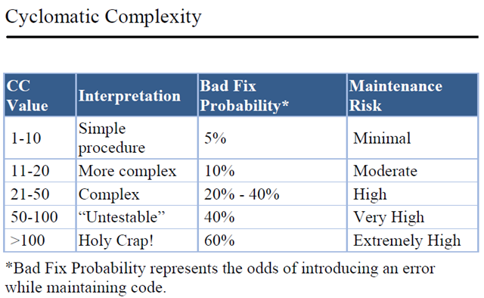
The Higher the Cyclomatic Complexity, the Harder the Code Is to Maintain

Slide 161
What Do We Mean by Linearly Independent Paths?
The number of linearly independent paths is the minimum number of end-to-end paths required to touch every path segment at least once.
Sometimes the actual number of paths needed to cover the system is less than this because it may be possible to combine several path segments in one traversal.
There may be more than one set of linearly independent paths for a given flowgraph
More likely as you get more complex flowgraphs
Determining a set of linearly independent paths is something you might study in a course on testing or in a course on graph theory
It gets harder as the cyclomatic complexity goes up

Slide 162
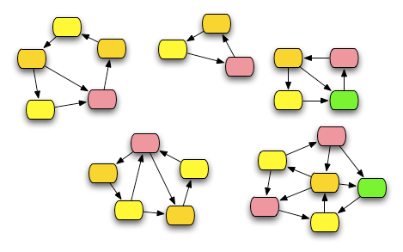
A Graph with Five Connected Components
This graph has five separate regions, which are connected within themselves, but not to each other. Each region is called a connected component.
The graph above is not a flowgraph by our strict definition, because it has more than one start and stop node and not all nodes are connected to any given start or stop node. But it illustrates the concept of connected components.

Slide 163
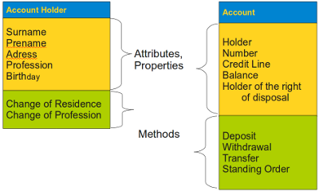
Why Would We Care About Graphs with Many Connected Components?
We could measure the cyclomatic complexity of a system consisting of several separate modules
In object oriented systems we could measure the cyclomatic complexity of a class containing multiple methods

Slide 164
McCabe Essential Complexity
The Essential Complexity (ev) of a Module or a System is:
The cyclomatic complexity of the fully reduced flowgraph
Example:
ev(F) = 1 because this can be reduced to one node
If the flowgraph is constructed completely of prime flowgraphs (i.e., it is structured) then the essential complexity will be 1.
A
B
C
D

Slide 165
Some Issues with Essential Complexity (slide 1 of 2)
Essential complexity is intended to tell us how well structured a program is.
However
As originally defined, the only valid primes were the four D structured primes: D₀, D₁, D₂, D₃
So if you allow additional primes, do you revise the definition of essential complexity to include the new primes?
Do you allow D₄ and D₅ but nothing else?
What about the C structured primes and the L structured primes?

Slide 166
Some Issues with Essential Complexity (slide 2 of 2)
If your program is not “structured” it isn’t clear whether the essential complexity tells us much beyond that
Does a larger essential complexity actually mean anything?
If two programs have the same essential complexity, are they equally complex?
See fig. 9.13 in Fenton for an example
He shows two flowgraphs that have the same essential complexity, but intuitively one of them is a lot more complex and harder to understand than the other.

Slide 167
Contents
Complexity: what and how to measure
Structured Programs and Flowgraph Analysis
Measures of Complexity
Closing Remarks

Slide 168
There is No Single Measure of Complexity
As we have seen, there are different ways to measure complexity
Research shows that sometimes the attributes of complexity may conflict
For example
low coupling doesn’t always mean high cohesion
low cyclomatic complexity doesn’t always mean easy to understand
structured software may be awkward to produce in languages without certain constructs
Use complexity measures as guidelines, not as “magic numbers” that result in rigid requirements for code.

Slide 169
END OF
Part 5
Notes:
This sign indicates it is time for one of the two breaks in the class

Slide 170

Any Questions?

Slide 171
End of
Lecture

Slide 172
References Part 3 (1 of 2)
Chatfield, C., Statistics for Technology, A Course in Applied Statistics, Third Edition, Chapman and Hall, London (1983), ISBN 978-0412253409.
Fenton, Norman and James Bieman, Software Metrics: A Rigorous and Practical Approach, Third Edition, Chapman and Hall, 2014. ISBN 978-1439838228, Chapter 6.
Hedstrom, John and Dan Watson, “Developing Software Defect Prediction,” Proceedings, Sixth International Conference on Applications of Software Measurement, 1995.
Jones, Capers, Applied Software Measurement, McGraw Hill, 1991. ISBN: 0-07-032813-7.
Knuth, Donald, Seminumerical Algorithms: The Art of Computer Programming, Vol II, Addison-Wesley, 1969. ASIN: B00157WFAU

Slide 173
References Part 3 (2 of 2)
Ott, R.L. and M. T. Longnecker, An Introduction to Statistical Methods and Data Analysis, 6th Edition, Duxbury Press (2008), ISBN 978-0495017585.
Snyder, Terry and Ken Shumate, Defect Prevention in Practice (Draft white paper), Hughes Aircraft Company, October 22, 1993.
Ross, Sheldon M.. Introduction to Probability Models, Academic Press, 1993. Musa, John, Software Reliability Engineering: More Reliable Software, Faster Development and Testing, McGraw Hill. ISBN: 0-07-913271-5.

Slide 174
References Part 4 (1 of 2)
Abran, A., et. al., “Functional Complexity Measurement”, Proceedings, IWSM 2001 - International Workshop on Software Measurement.
Chidamber, S. and Chris Kemerer, A Metrics suite for Object Oriented Design, MIT Sloan School of Management E53-315 (1993).
Fenton, Norman and James Bieman, Software Metrics: A Rigorous and Practical Approach, Third Edition, Chapman and Hall, 2014. ISBN 978-1439838228, Chapter 9
Fenton, N. and A. Melton, “Deriving Structurally Based Software Measures,” Journal of System Software, vol 12 (1990), pp 177-187.
Henry, S. and D. Kafura, “Software Structure Metrics Based on Information Flow”, IEEE Transactions on Software Engineering, Volume SE-7, No. 5 (Sept, 1981), pp 510-518.

Slide 175
References Part 4 (2 of 2)
IEEE 9982.2 (1988). IEEE Guide for the Use of IEEE Standard Dictionary of Measures to Produce Reliable Software, A25. Data of Information Flow Complexity. P112.
Stevens, W., G. Myers and L. Constantine, “Structured Design”, IBM Systems Journal, vol 13, no 2 (1974), pp 115-139.
Kitchenham, B. A., “Measuring to Manage”, in Mitchell, Richard J. (editor), Managing Complexity in Software Engineering, London, Peter Peregrinus, Ltd. (1990). ISBN 0 86341 171 1
Lavazza, L. and G. Robiolo, “Functional Complexity Measurement: Proposals and Evaluations”, Proceedings of ICSEA 2011: the Sixth International Conference on Software Engineering Advances.

Slide 176
References Part 5
Dijkstra, Edsger, “GO TO Considered Harmful”, letter to the editor of Communications of the ACM, March, 1968.
Fenton, Norman and James Bieman, Software Metrics: A Rigorous and Practical Approach, Third Edition, Chapman and Hall, 2014. ISBN 978-1439838228, Chapter 9
Fenton, N. and A. Melton, “Deriving Structurally Based Software Measures,” Journal of System Software, vol 12 (1990), pp 177-187.
McCabe, Thomas, “A complexity measure,” IEEE Transactions on Software Engineering, vol SE-2, issue 4 (December, 1976), pp 308-320.
Stevens, W., G. Myers and L. Constantine, “Structured Design”, IBM Systems Journal, vol 13, no 2 (1974), pp 115-139.

Slide 177
Exercise
Given a Program, Determine its Flowgraph and its Cyclomatic Complexity

Slide 178
Instructions
Review the program (handout) and draw its flowgraph
Compute the Cyclomatic Complexity
Report to the Class
Option:
One or more students may be asked to explain their flowgraph to the class

